Slide 1
Federation vs Distribution
Datalog vs SPARQL

Slide 2
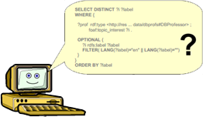
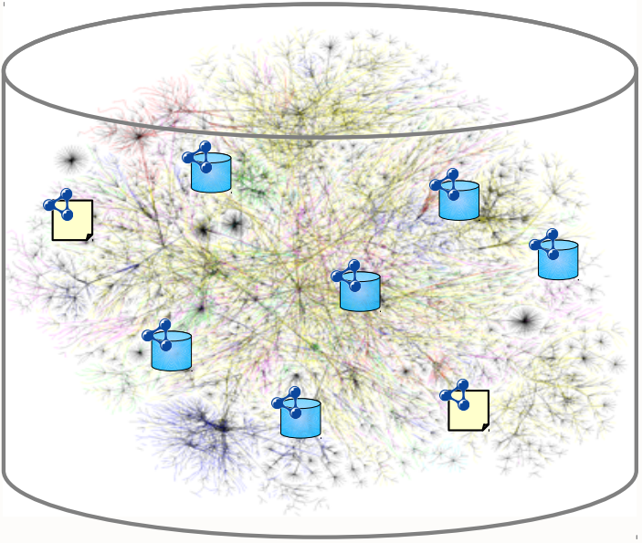
General issue
Linked Data/
Linked Open Data (LOD)
  Web of Data
Query language
  Distributed environment
  Semantic context
  Parallel execution
  Efficient,…
Web of Data

Slide 3
Querying the web of linked data
Warehousing approach
Mediator approach
  Federated approach
  Distributed approach (in general)

Slide 4
Dataset in linked data
Suppose all database are in RDF format
  If data is stored in other format, it can be pre-process to transform to RDF format
The limited ability of dataset “endpoint”
  “endpoint”: a service accepting queries and return results
  Ex: many SPARQL endpoints are designed for very lightweight use
    Could not answer complex queries
    Unable to retrieve data from other endpoints
    Set a limited timeout for each query.
  According to LOD cloud statistics, there are over 65% of the RDF repositories equipped with SPARQL Endpoints.

Slide 5


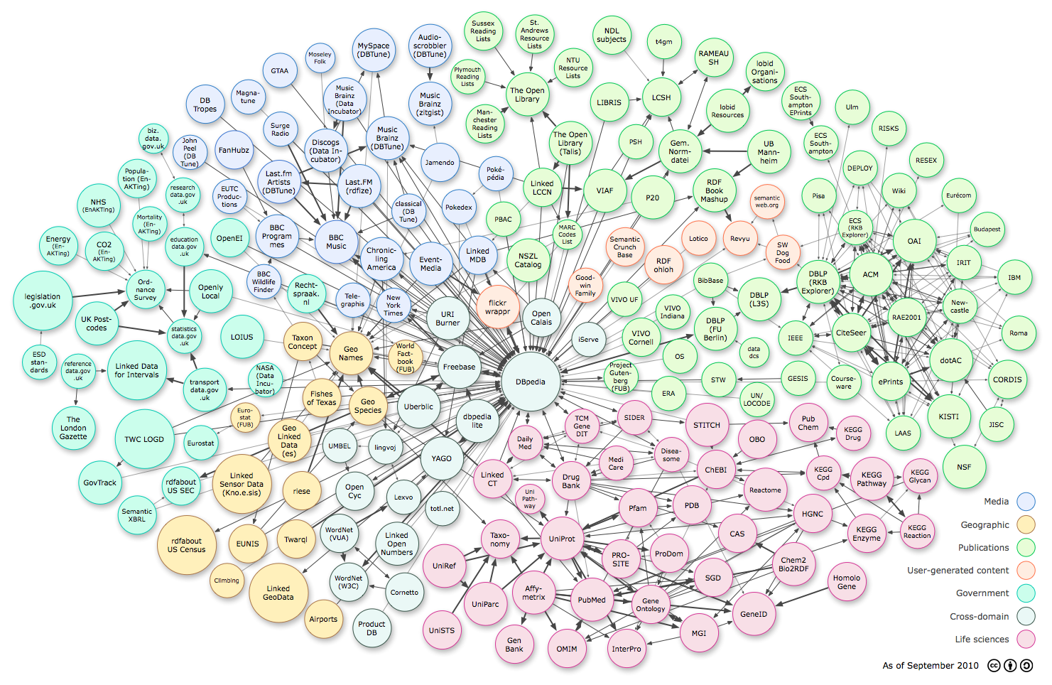
Dataset in linked data
Access
Republication Component
Integrated Dataset
(Triple Store)
Republication
LD Data set
Data Access Component
Data Integration Component
Vocabulary Mapping
Interlinking
Cleansing
Physical Wrapper
SPARQL Wr.
R2R Transf.
LD Wrapper
Data acquisition
RDF/ XML
SPARQL Endpoints
Web Data accessed via APIs
Relational Data
Linked Data
Notes:
As you can see in this figure, I suppose that we have many kind of data sources in a particular domain (ex: music). These data sources can be SPARQL endpoint, the relational data, the data that can be retrieved through particular APIs, etc.
For each kind of data, we can use a specific tool called wrapper to convert the data in diverse format into RDF format, then the converted data is integrated through some step such as cleaning (to reduce redundancy), mapping vocabulary, interlinking, etc. in order to create a uniform and complete linked data in that domain (ex: music).

Slide 6
Dataset in linked data
The scope of query:
  full-Web semantics: the complete set of Linked Data on the Web
    Olaf Hartig¹ (2012) show that not any approach for executing such SPARQL-based queries can guarantee complete query results.
  reachability-based semantics: restrict the scope to data
    -> must have a semantic manner to guarantee the computed result is the same as expected result.
(1) O. Hartig. SPARQL for a Web of Linked Data: Semantics and Computability, 2012

Slide 7
Warehousing based approach
Data from sources are loaded into the warehouse ahead of query time.
Adv:
  Most efficient
Disad:
  Misses unknown/new sources
  Data out of date
Query
Warehouse
load
load
load
load

Slide 8
Federated approach
The mediator distributes sub-queries to relevant sources and integrates the results.
  Accept queries
  Decompose query into subqueries
  Delivers subqueries to sources
  Integrates results
Query
Mediator

Slide 9
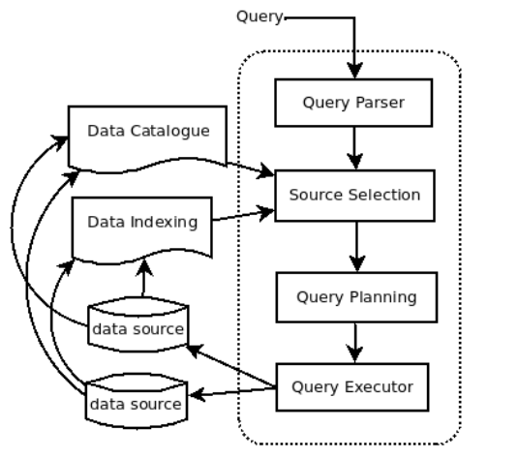
Federated approach
Federated query process¹
  Query parser
  Source selection
    Reduce:
      intermediate results
      communication cost
    Common methods:
      Catalogue, Indexing, statistics,…
  Query planning
  Query executor
(1) Nur Aini Rakhmawati et al., Querying over Federated SPARQL Endpoints, 2013

Slide 10
Federated approach
Existing solutions:
  SPARQL → Federation extension¹ (SPARQL 1.1)
  Datalog → WebdamLog²
Adv
  Fresh information
Disad
  Have to know the relevant sources in advance.
    Restricts to the selected sources
    Misses unknown/new sources
    Tackle changeable sources
http://www.w3.org/TR/2013/REC-sparql11-federated-query-20130321/
Abiteboul, Distributed Datalog Revisited, 2012

Slide 11
Distributed approach (in general)
Similar federated approach
  Set of sources is unstable and large number
  Unable know sources in advance
    Schema, data,…
    Need a global schema (?)
  Decompose and build
  subqueries automatically
    Adaptable to sources change
  Execute in parallel way
Query
Mediator
(Global schema)
Query processor

Slide 12
Distributed approach (in general)
(probable) resolving direction basing on federated approach (?)
Global schema
Treated automatically and adapt to sources change
parallel

Slide 13
Distributed approach (in general)
Other challenges
  Web of Data has no global schema¹
    How to build global schema?
    Necessary?
  Data Access and Security
    Tackle authentication mechanism of sources
  Redundant, contradicted or “fuzzy” results
  …
(1) A. Freitas, Querying heterogeneous datasets on the linked data web: Challenges, approaches, and trends. IEEE, 2012.

Slide 14
SPARQL vs Datalog
 | DataLog | SPARQL 1.0 | SPARQL 1.1
Projection | yes | yes | yes
Constraints on structure | yes | yes | yes
Constraints on values | yes | yes | yes
Graph construction | yes | yes | yes
Boolean queries | yes | yes | yes
Disjunction/UNION | no | yes | yes
Nesting queries | yes | no | yes
Aggregate functions | no¹ | no | yes
­Recursion | yes² | no | no?
Negation/ Set Difference | yes* | yes | yes
Data manipulation features | no | no | yes
Transaction control | no | no | no
Navigation | yes | no | yes
Federation | no | no | yes
Parallel | ? | ? | ?
^{[1]} [wiki] http://en.wikipedia.org/wiki/Datalog
^{[2]} [article] 2013 Arenas – Expressive language for querying the semantic web
^{* With extension}

